Slide 1
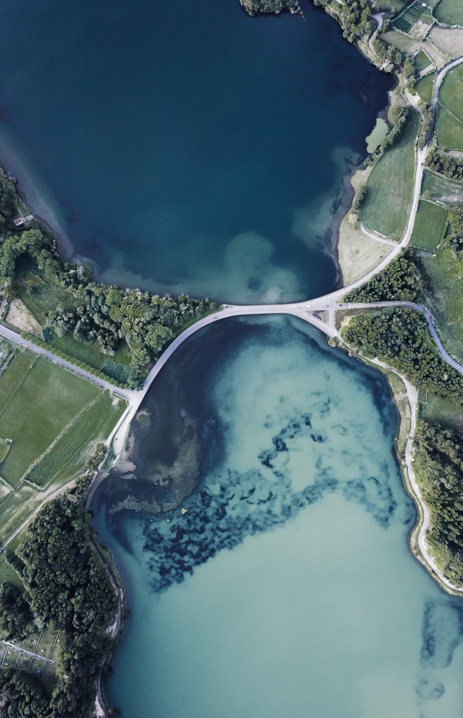

IoT-enabled sensor for water quality prediction using machine learning
Name: Palok Biswas
Matric Number: WOA180016
Supervisor: Dr. Zati Hakim Azizul Hasan
Department: Artificial Intelligence, FCSIT

Slide 2
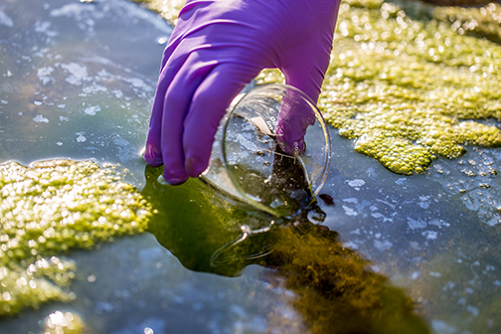
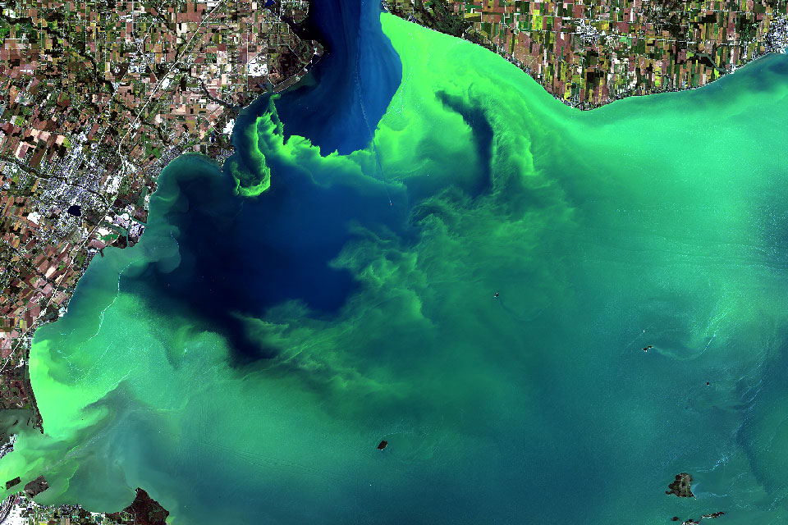
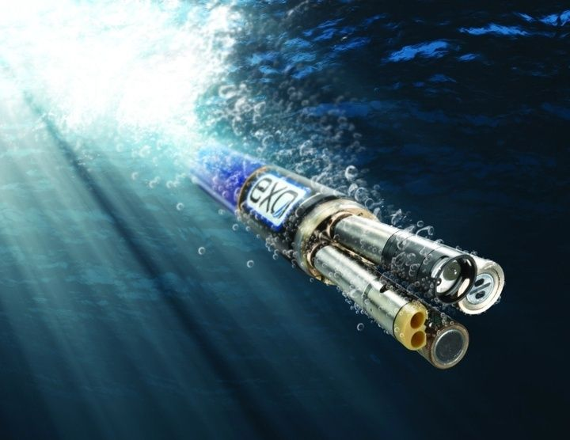
Background
About 60% of Malaysian lakes suffer from eutrophication
Eutrophication or algal bloom is caused by excessive organic nutrients (a by product of human activities)
For prevention, NAHRIM proposed continuous water sampling to detect degradation at early stages
Currently, water sampling is done manually, involving expedition with boats
Preferably done in-situ by dipping hand-held sonde into water
Common 5 parameters to sample include pH, temperature, conductivity, turbidity and dissolve oxygen (Koparan, 2018)
For eutrophication, usually test in the lab for Chlorophyll-a
Grab Sampling
Algal Bloom
YSI EXO Sonde

Slide 3
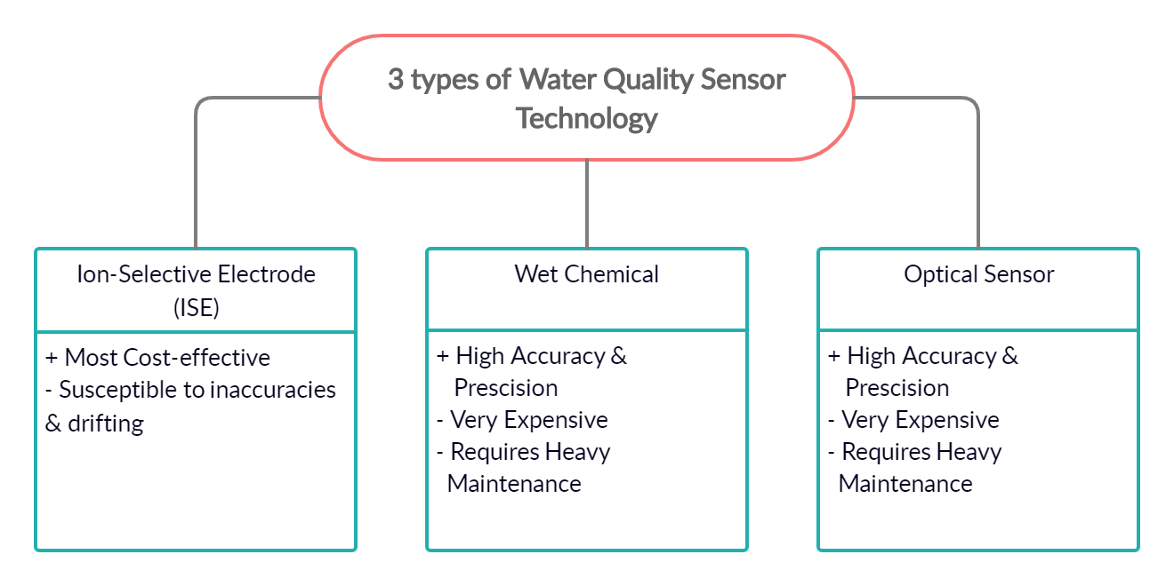
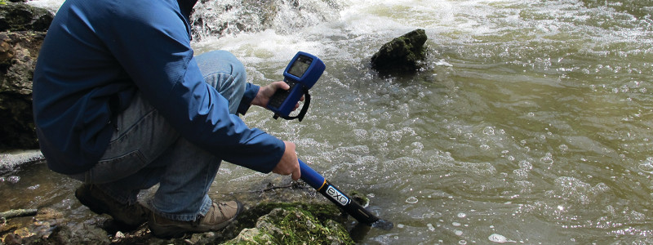
BACKGROUND
Often these in situ sensors are expensive and not IoT-enabled
Data is recorded in USB and manually transferred from sonde to another platform for processing
Not feasible for continuous real-time monitoring
State-of-the-art water sampling (YSI EXO1 Sonde)

Slide 4
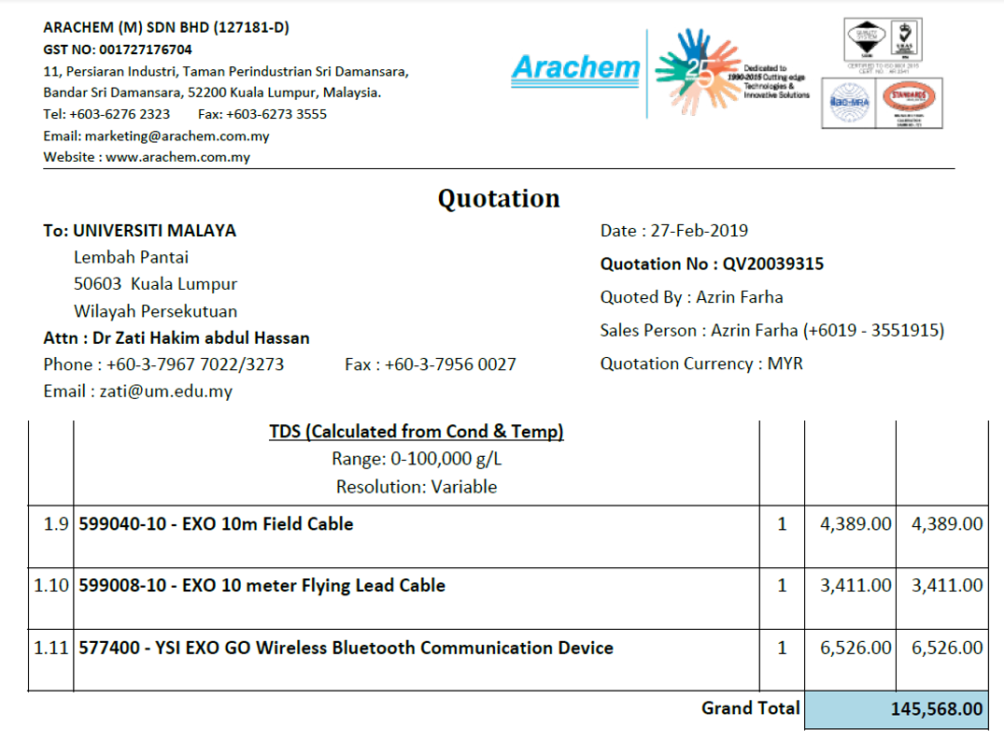
MOTIVATION
As a rough guideline on the cost, a normal sonde with 5 common water parameters i.e. pH, temperature, conductivity, turbidity and dissolve oxygen costs RM41,000
To include IoT-enabled features, require another RM76,000
Sample Quotation for EXO GO IoT-enabled multiparameter sonde, 2019

Slide 5
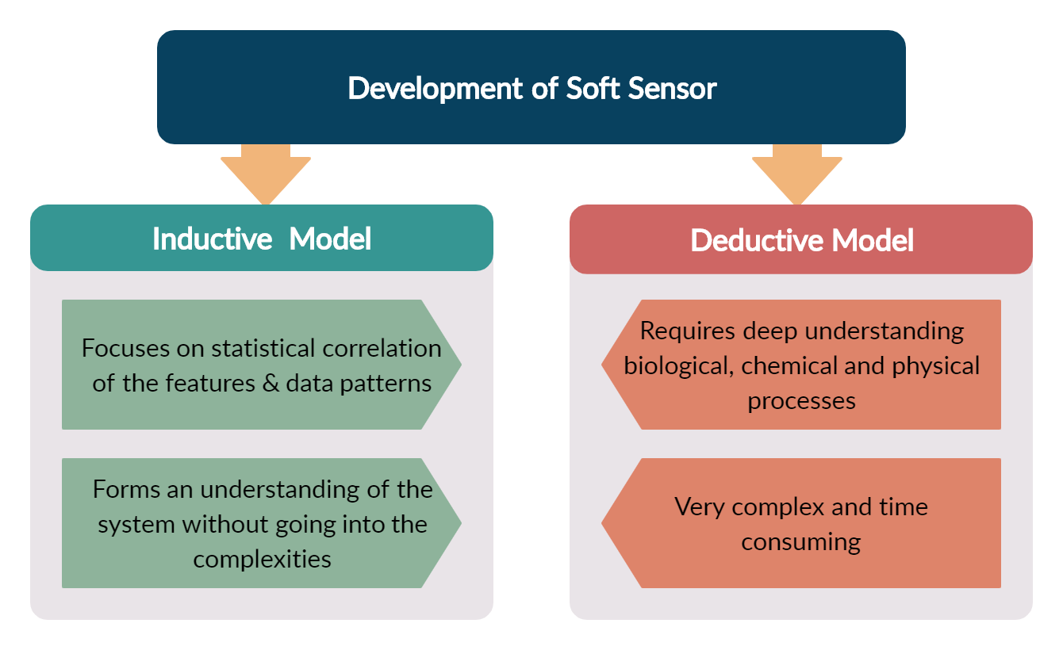
MOTIVATION
It is possible to predict the parameter based on other available water quality parameters using a machine learning model and is termed a soft sensor (Castrillo & García, 2020).
Algorithms like ANN is a good example of inductive modelling that can predict parameters like Chlorophyll-a (Tian et al., 2017) from 5 basic water parameters i.e. pH, temperature, conductivity, turbidity and DO

Slide 6
Literature Review
Chlorophyll-A Prediction
Reference | Aim | Algorithm | Findings | Gap
Huo et al. (2013) | Eutrophication (Algal bloom) prediction and tropic state of the water body is determined by predicting chlorophyll-a which is the prime indicator for eutrophication | Back Propagation NN | Nonlinear relationship between Chl-a and input parameters | Requires a lot of input parameters
Zhang et al. (2016) |  | Deep Belief Network | Dependent on meteorological, hydrological and other biochemical processes | Most input parameters cannot be measured in real time
Tian et al. (2017) |  | Back Propagation NN | Temp, TSS, TP & NP influence Chl-a and Transparency | Trained on a limited dataset
Yi et al. (2018) |  | Extreme Learning Model | Region of rivers have different | Predictive models are specific to a waterbody
Mamun et al. (2020) |  | Support Vector Machine | Rainfall, solar radiation | Relies on expensive sensors and sensitive to de-calibration
Jimeno-Sáez et al. (2020) |  | Support Vector Regression | Chl-a data is a non-stationary time series process which makes prediction difficult

Slide 7
Literature Review
WQI Prediction
Reference | Aim | Algorithm | Findings | Gap
Camejo et al. (2013) | Water Quality is assessed to estimate the WQI and also water is also classified according to the water quality standards | k-Nearest Neighbour, | Deep learning outperforms other models like kNN & SVM | SVR relies on a lot of input parameters
Yan et al. (2017) |  | Extreme Learning Machine |  | Trained on a limited dataset
Shafi et al. (2018) |  | Deep Neural Network |  | Some parameters cannot be measured in real time
Ahmed et al. (2019) |  | Gradient Boosting & Polynomial Regression
Li et al. (2019) |  | Hybrid Support Vector Regression

Slide 8
Literature Review
Parameter Retrieval
Reference | Aim | Algorithm | Findings | Gap
Keller et al. (2018) | Retrieved certain water quality parameters that cannot be measured in situ in order to enable instantaneous remote sensing | ANN, SVM, Extremely Randomized trees (ET), | Neural Networks are superior when it comes to parameter retrieval compared to other ML models | Satellite images are not available in cloudy and dusty weather
Ruescas et al. (2018) |  | Random Forest Regression, Gaussian Process Regression |  | Hyperspectral or Multispectral radiometers are very expensive
Hafeez et al. (2019) |  | ANN
Shehhi & Kaya (2020) |  | Regression & Neural Network (Nonlinear Auto Regressive)

Slide 9
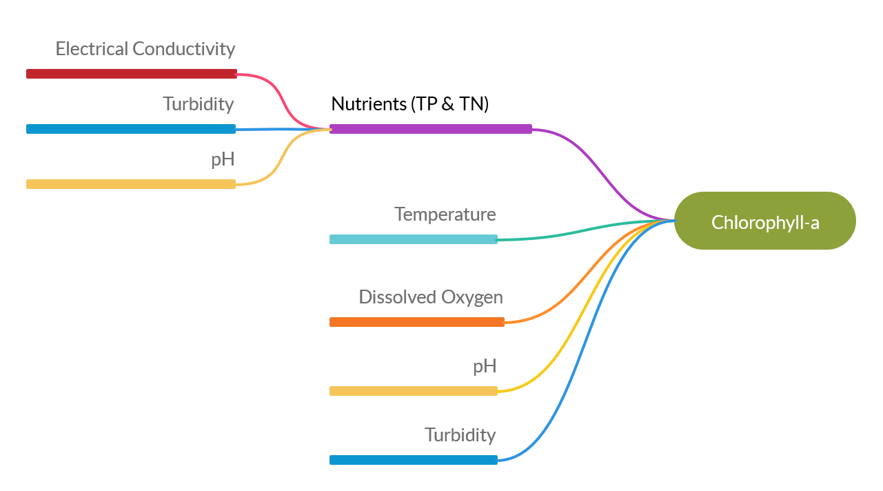
CORRELATION MAP
Studies showed that Chlorophyll-a is significantly correlated with temperature, DO, pH, Transparency, Total Suspended Solids (TSS) and nutrients namely, total nitrogen (TN) and total phosphorus (TP) (Huo et al. 2013; Mamun et al. 2020).
These nutrients (Phosphorus and Nitrogen compounds) in turn are correlated with Electrical Conductivity, Turbidity and pH.

Slide 10
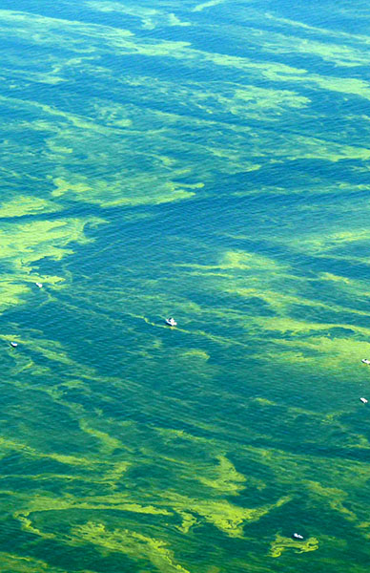
Problem statement
In-situ sampling is preferred for continuous real-time monitoring of water quality but there is no cost-effective sensor for chlorophyll-a
Chlorophyll-a can be predicted using machine learning models with 5 basic water parameters; pH, temperature, conductivity, turbidity and DO
Hypothetically, IoT-enabled sensor with 5 basic water parameters will be able to effectively model chlorophyll-a concentration to determine eutrophication level at lakes

Slide 11
RESEARCH MAPPING
Research Questions | Research Objectives | Research Methodology | Research Outcome
What are the various methods and core parameters of lake water sampling? | To study different monitoring methods for efficient lake water sampling and parameters to accurately predict Chlorophyll-a | Systematic literature review | Findings on the performance of existing approaches Core parameters for water quality monitoring and Chlorophyll-a prediction
How accurate are the in-situ measurements compared to laboratory equipment? | To compare the IoT sensor data with laboratory equipment for the same water samples. | Calibration of sensors Comparative performance evaluation & validation | Develop IoT-enabled sensor Develop ML-based soft sensor Visualize the data on the backend using web browser
Is the proposed prototype a feasible solution for a real-time lake water sampling? | To test the performance of the proposed prototype in real-time | Providing water quality sensor to WQ researchers | New findings on the proposed prototype in terms of feasibility and accuracy
How does the performance of the proposed prototype differ from standard methods? | To evaluate and compare the performance of the proposed prototype with standard methods of measurement | Comparative evaluation | Results of performance comparison with existing solutions
Your company name

Slide 12
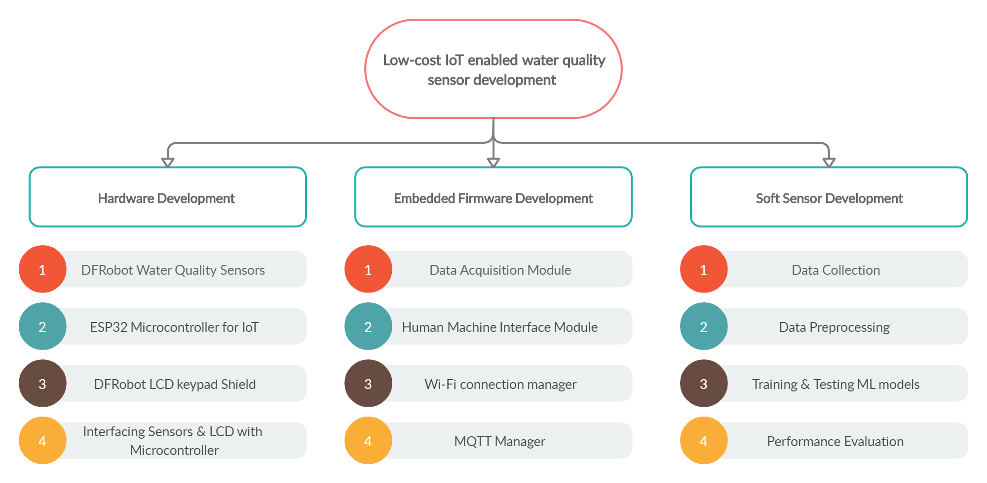
SCOPE OF STUDY

Slide 13
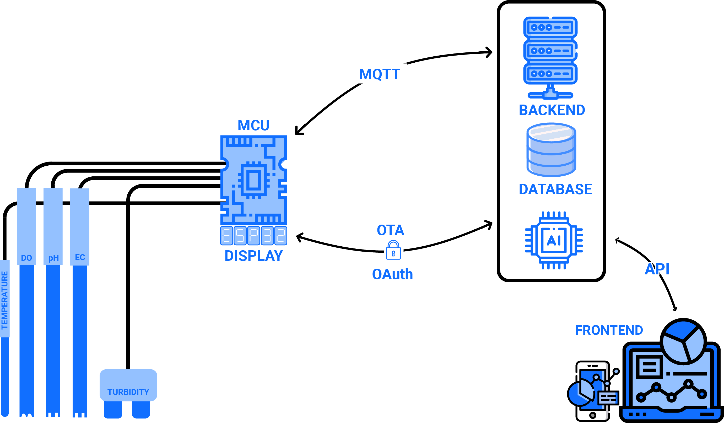
PROPOSED SOLUTION

Slide 14
METHODOLOGY
Development of low-cost IoT enabled multiparameter sensor (5 WQ parameters)
Sensor calibration
Develop chlorophyll-a soft sensor
Testing and Evaluation

Slide 15
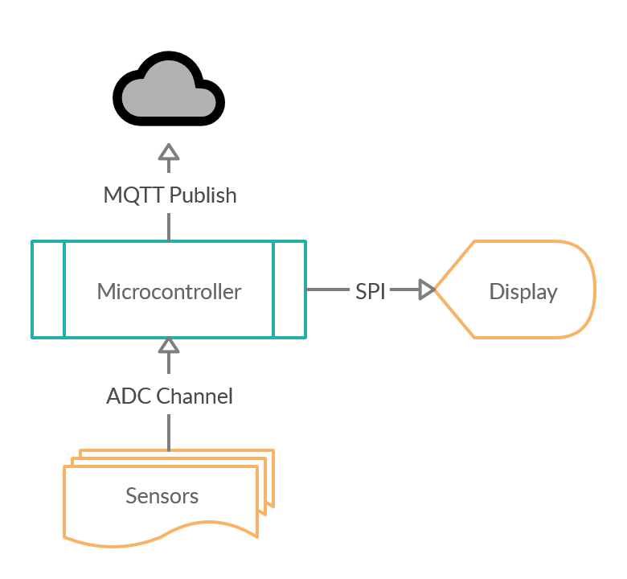
METHODOLOGY
Hardware Development (Completed)

Slide 16
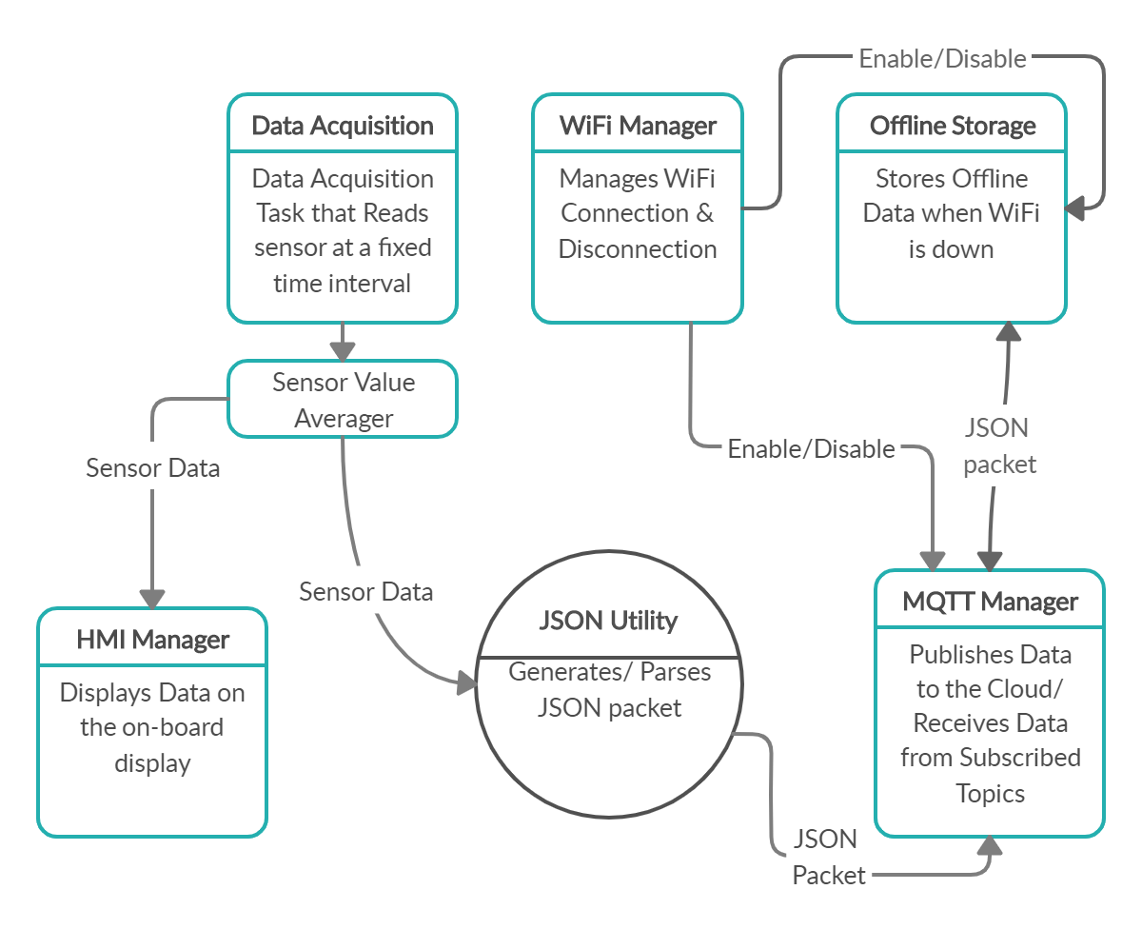
METHODOLOGY
Firmware Development (Completed)

Slide 17
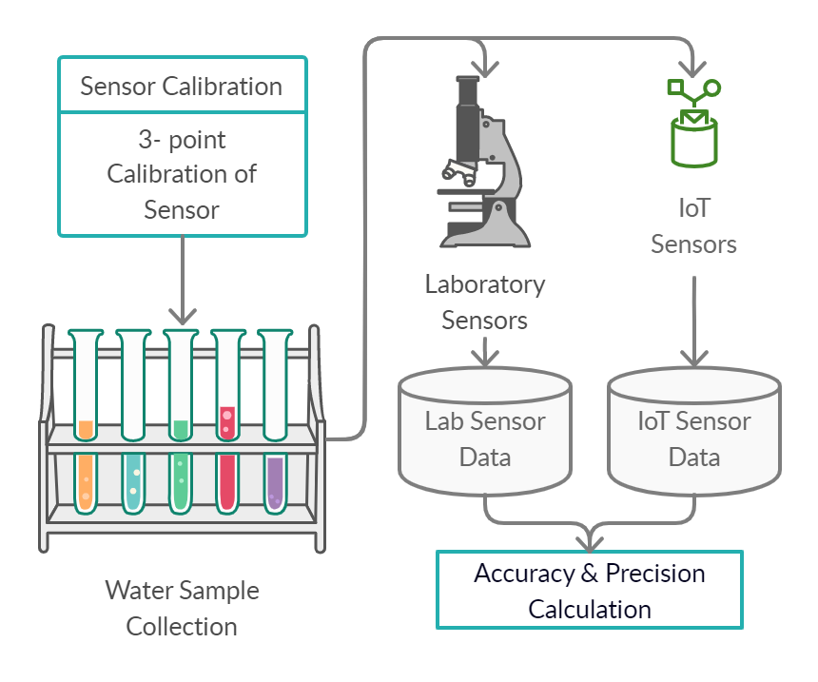
METHODOLOGY
Sensor calibration (on-going)
Calibrate using standard solutions for each parameters
Measure real water samples with IoT Sensor & Lab sensor
Evaluate the performance of the IoT sensor against lab sensor data

Slide 18
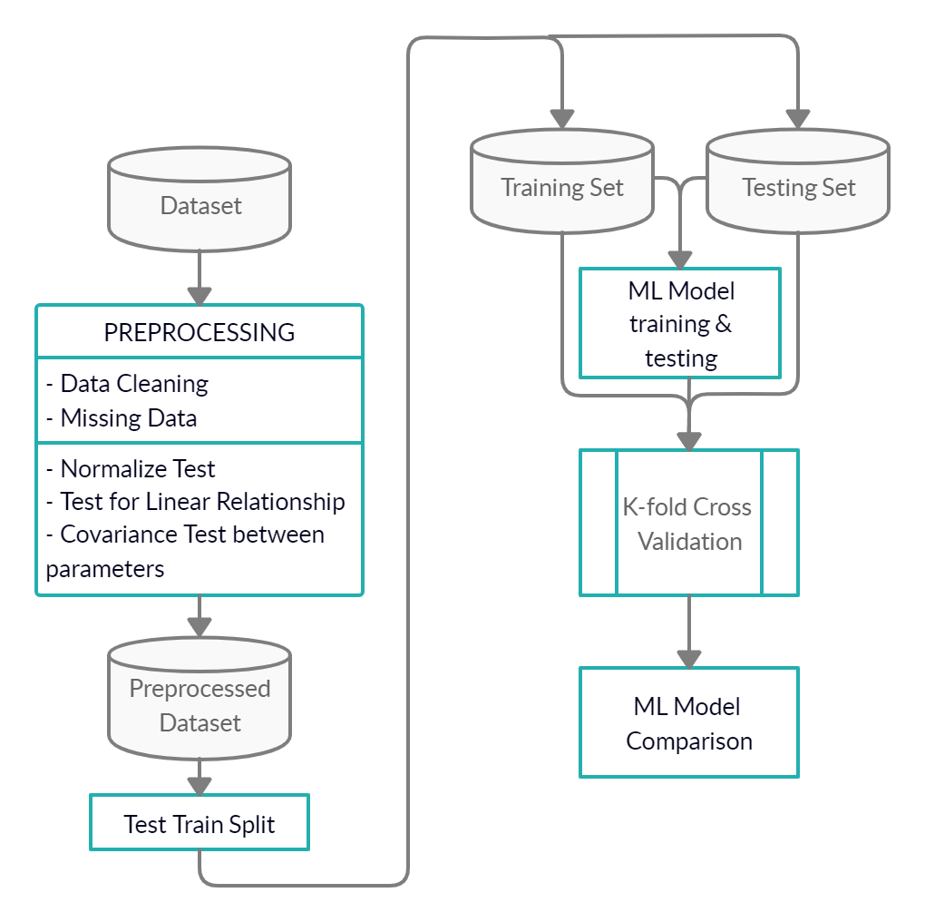
METHODOLOGY
Machine learning model for chlorophyll-a prediction
The machine learning models selected for this study (SVM, SVR, Deep Learning, ELM, RF and ANN)
to assess which model performs best, k-fold cross validation test will be used

Slide 19
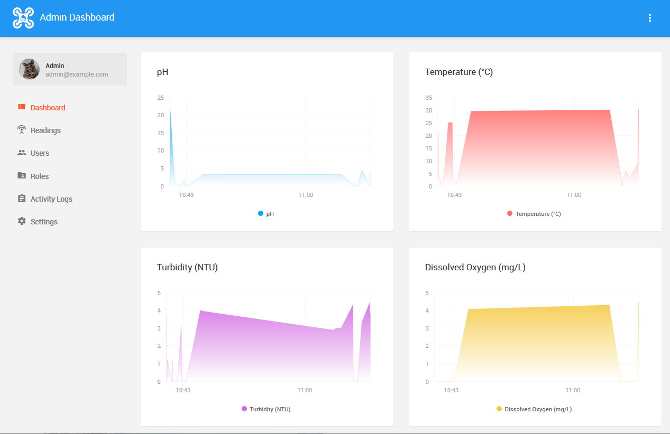
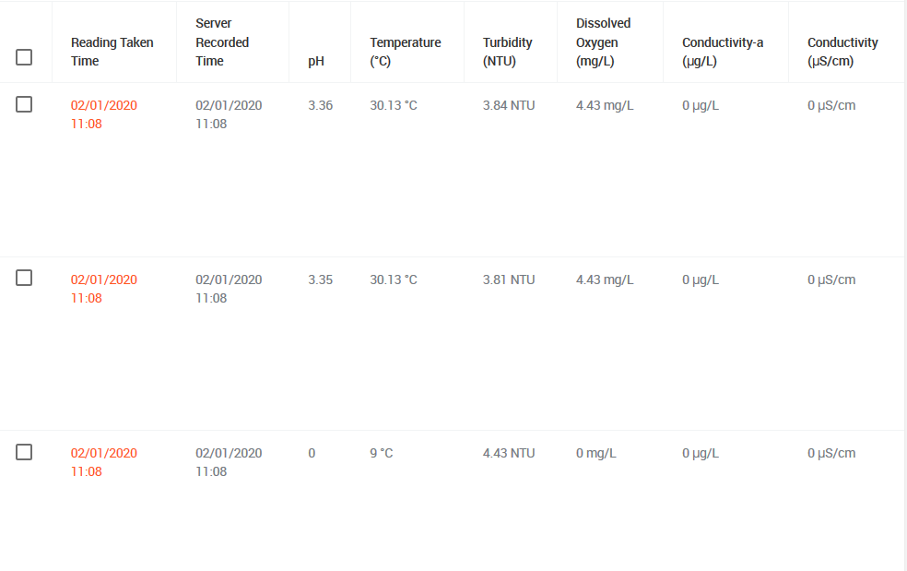
DATA VISUALIZATION

Slide 20
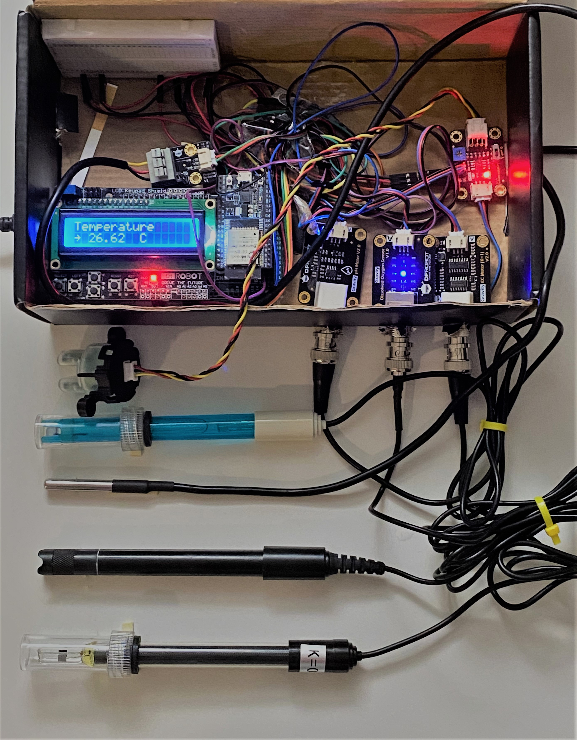
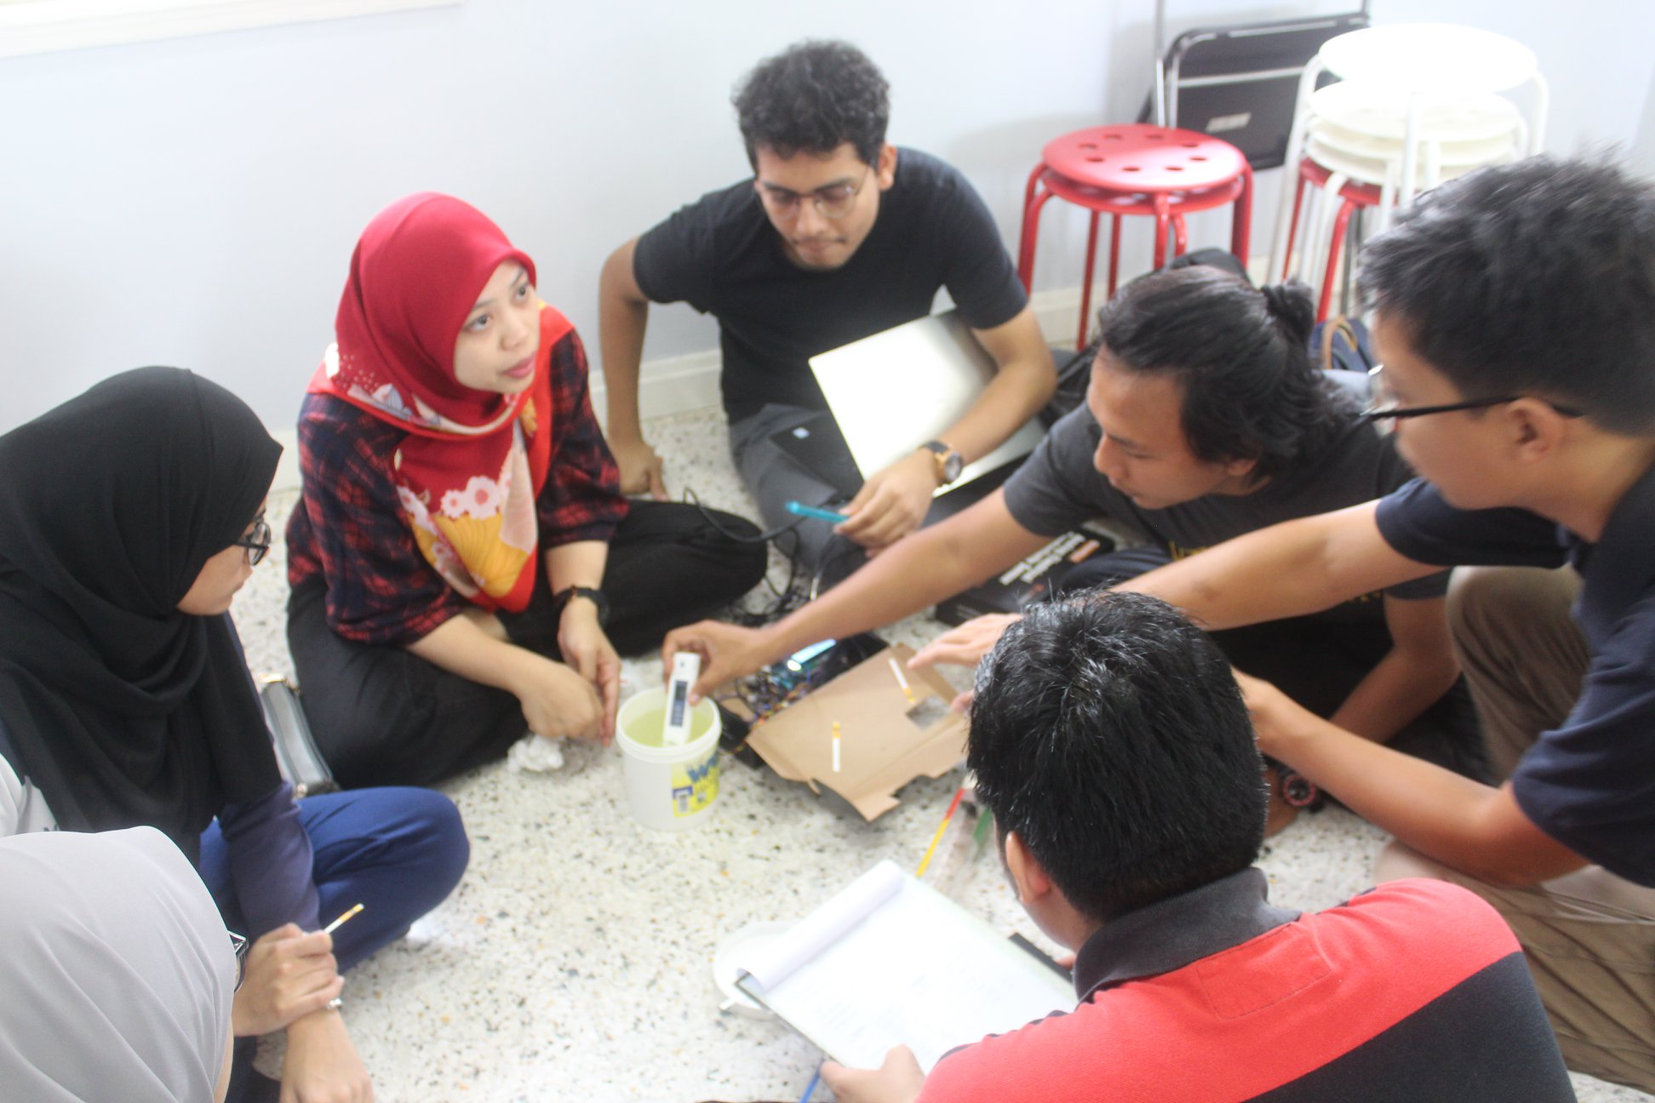
USER ACCEPTANCE TESTING
Testing and evaluation
User acceptance evaluation by project impact partner, Water Warriors (UM)

Slide 21
CURRENT PROGRESS & ACHIEVEMENT
Photo of sensor and dashboard
2019 NCKU Maker Festival and International Student Innovation Competition, Taiwan
Won 3rd place for earlier prototype of the IoT-enabled low-cost water quality device

Slide 22
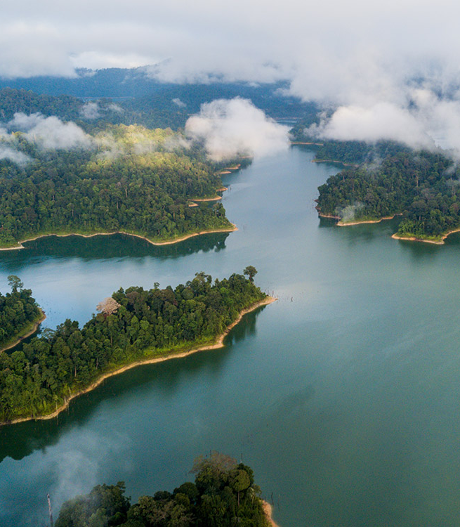
CHALLENGES
Acquisition of time series data for Malaysian lakes
Sv working to get data by DOE through collaborator NAHRIM

Slide 23
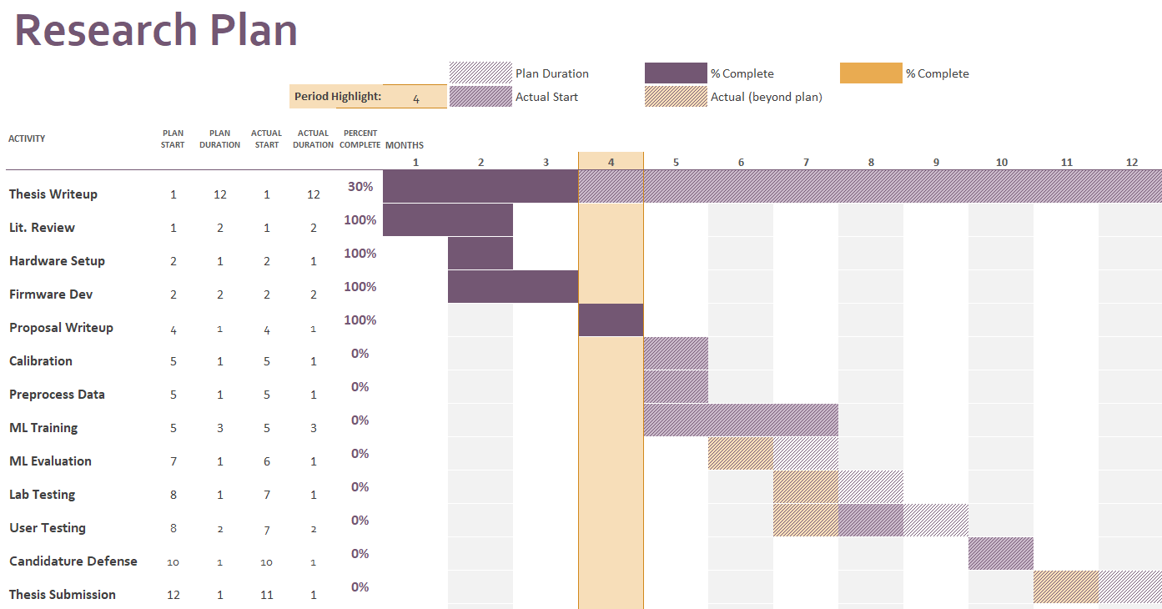

Slide 24

CONCLUSION
This research contributes to the improvement of water quality monitoring of water bodies (lakes) in Malaysia.
Specifically, it addresses the mitigation measures under the Environmental Quality Act (1974) and more generally, the National Water Resources Policy (2012).
It is also related to the SDG6 aspects in the upcoming Rancangan Malaysia ke-12, especially on integrated water resource management

